Slide 1
ICS 3103 Communication Systems
Introduction to Waves
Prof. Cheruiyot W.K, PhD
JKUAT-SCIT
Computing Department
Email: wilchery68@gmail.com

Slide 2
Course Description
Analysis and synthesis of waveforms. Modulation. Communication channels (media), their natures and characteristics. Measures of information, Gausian sources and channels, etc. Performance criteria and limits of communication systems,. Bandwidth utilization efficiency, bandwidth expansion factor, signal-to-noise power ration, error probabilities. Shannon techniques, eg envelope, angle, composite, PCD, channel coding for error control and security, study of common as well as emerging communication technologies and systems, eg copper wire, coaxial cable, fiber optics, satellite, terrestrial microwave, broadcast and mobile radio, PSTN, cellular radio.
Principles of multiplexing and public switched telephone networks: wireless communication systems. Cellular communication system, protocols and standards.

Slide 3
Expectations
Assignments 20%
Presentations(term papers and journals) 20%
Exams 60%

Slide 4
Waves are everywhere in nature
  Sound waves,
  visible light waves,
  radio waves,
  microwaves,
  water waves,
  sine waves,
  telephone chord waves,
  stadium waves,
  earthquake waves,
  waves on a string,
  slinky waves

Slide 5

What is a wave?
a wave is a disturbance that travels through a medium from one location to another.
a wave is the motion of a disturbance

Slide 6
Slinky Wave
Let’s use a slinky wave as an example.
When the slinky is stretched from end to end and is held at rest, it assumes a natural position known as the equilibrium or rest position.
To introduce a wave here we must first create a disturbance.
We must move a particle away from its rest position.

Slide 7
Slinky Wave
One way to do this is to jerk the slinky forward
the beginning of the slinky moves away from its equilibrium position and then back.
the disturbance continues down the slinky.
this disturbance that moves down the slinky is called a pulse.
if we keep “pulsing” the slinky back and forth, we could get a repeating disturbance.

Slide 8

Slinky Wave
This disturbance would look something like this
This type of wave is called a LONGITUDINAL wave.
The pulse is transferred through the medium of the slinky, but the slinky itself does not actually move.
It just displaces from its rest position and then returns to it.
So what really is being transferred?

Slide 9
Slinky Wave
Energy is being transferred.
The metal of the slinky is the MEDIUM in that transfers the energy pulse of the wave.
The medium ends up in the same place as it started … it just gets disturbed and then returns to it rest position.
The same can be seen with a stadium wave.

Slide 10
Longitudinal Wave
The wave we see here is a longitudinal wave.
The medium particles vibrate parallel to the motion of the pulse.
This is the same type of wave that we use to transfer sound.
Can you figure out how??
show tuning fork demo

Slide 11
Transverse waves
A second type of wave is a transverse wave.
We said in a longitudinal wave the pulse travels in a direction parallel to the disturbance.
In a transverse wave the pulse travels perpendicular to the disturbance.

Slide 12
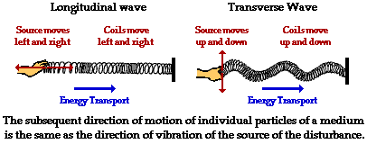
Transverse Waves
The differences between the two can be seen

Slide 13
Transverse Waves
Transverse waves occur when we wiggle the slinky back and forth.
They also occur when the source disturbance follows a periodic motion.
A spring or a pendulum can accomplish this.
The wave formed here is a SINE wave.
http://webphysics.davidson.edu/course_material/py130/demo/illustration16_2.html

Slide 14
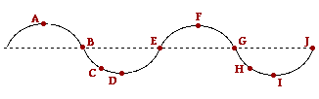
Anatomy of a Wave
Now we can begin to describe the anatomy of our waves.
We will use a transverse wave to describe this since it is easier to see the pieces.

Slide 15
Anatomy of a Wave
In our wave here the dashed line represents the equilibrium position.
Once the medium is disturbed, it moves away from this position and then returns to it

Slide 16
Anatomy of a Wave
crest
The points A and F are called the CRESTS of the wave.
This is the point where the wave exhibits the maximum amount of positive or upwards displacement

Slide 17
Anatomy of a Wave
trough
The points D and I are called the TROUGHS of the wave.
These are the points where the wave exhibits its maximum negative or downward displacement.

Slide 18
Anatomy of a Wave
Amplitude
The distance between the dashed line and point A is called the Amplitude of the wave.\
This is the maximum displacement that the wave moves away from its equilibrium.

Slide 19
Anatomy of a Wave
wavelength
The distance between two consecutive similar points (in this case two crests) is called the wavelength.
This is the length of the wave pulse.
Between what other points is can a wavelength be measured?

Slide 20
Anatomy of a Wave
What else can we determine?
We know that things that repeat have a frequency and a period. How could we find a frequency and a period of a wave?

Slide 21
Wave frequency
We know that frequency measure how often something happens over a certain amount of time.
We can measure how many times a pulse passes a fixed point over a given amount of time, and this will give us the frequency.

Slide 22
Wave frequency
Suppose I wiggle a slinky back and forth, and count that 6 waves pass a point in 2 seconds. What would the frequency be?
  3 cycles / second
  3 Hz
  we use the term Hertz (Hz) to stand for cycles per second.

Slide 23
Wave Period
The period describes the same thing as it did with a pendulum.
It is the time it takes for one cycle to complete.
It also is the reciprocal of the frequency.
T = 1 / f
f = 1 / T
let’s see if you get it.

Slide 24
Wave Speed
We can use what we know to determine how fast a wave is moving.
What is the formula for velocity?
  velocity = distance / time
What distance do we know about a wave
  wavelength
and what time do we know
  period

Slide 25
Wave Speed
so if we plug these in we get
  velocity =
  length of pulse /
  time for pulse to move pass a fixed point
  v = λ / T
  we will use the symbol λ to represent wavelength

Slide 26
Wave Speed
v = λ / T
but what does T equal
  T = 1 / f
so we can also write
  v = f λ
  velocity = frequency * wavelength
This is known as the wave equation.
examples

Slide 27
Wave Behavior
Now we know all about waves.
How to describe them, measure them and analyze them.
But how do they interact?

Slide 28
Wave Behavior
We know that waves travel through mediums.
But what happens when that medium runs out?

Slide 29
Boundary Behavior
The behavior of a wave when it reaches the end of its medium is called the wave’s BOUNDARY BEHAVIOR.
When one medium ends and another begins, that is called a boundary.

Slide 30
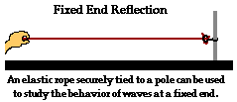
Fixed End
One type of boundary that a wave may encounter is that it may be attached to a fixed end.
In this case, the end of the medium will not be able to move.
What is going to happen if a wave pulse goes down this string and encounters the fixed end?

Slide 31
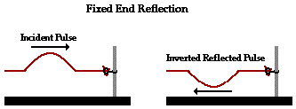
Fixed End
Here the incident pulse is an upward pulse.
The reflected pulse is upside-down. It is inverted.
The reflected pulse has the same speed, wavelength, and amplitude as the incident pulse.

Slide 32
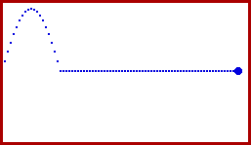
Fixed End Animation

Slide 33
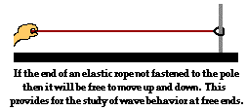
Free End
Another boundary type is when a wave’s medium is attached to a stationary object as a free end.
In this situation, the end of the medium is allowed to slide up and down.
What would happen in this case?

Slide 34
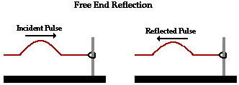
Free End
Here the reflected pulse is not inverted.
It is identical to the incident pulse, except it is moving in the opposite direction.
The speed, wavelength, and amplitude are the same as the incident pulse.

Slide 35
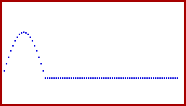
Free End Animation

Slide 36

Change in Medium
Our third boundary condition is when the medium of a wave changes.
Think of a thin rope attached to a thin rope. The point where the two ropes are attached is the boundary.
At this point, a wave pulse will transfer from one medium to another.
What will happen here?

Slide 37
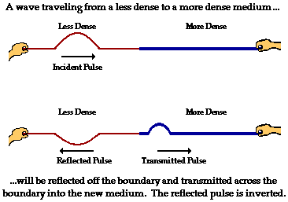
Change in Medium
In this situation part of the wave is reflected, and part of the wave is transmitted.
Part of the wave energy is transferred to the more dense medium, and part is reflected.
The transmitted pulse is upright, while the reflected pulse is inverted.

Slide 38
Change in Medium
The speed and wavelength of the reflected wave remain the same, but the amplitude decreases.
The speed, wavelength, and amplitude of the transmitted pulse are all smaller than in the incident pulse.

Slide 39

Change in Medium Animation
Test your understanding

Slide 40
Wave Interaction
All we have left to discover is how waves interact with each other.
When two waves meet while traveling along the same medium it is called INTERFERENCE.

Slide 41
Constructive Interference
Let’s consider two waves moving towards each other, both having a positive upward amplitude.
What will happen when they meet?

Slide 42


Constructive Interference
They will ADD together to produce a greater amplitude.
This is known as CONSTRUCTIVE INTERFERENCE.

Slide 43
Destructive Interference
Now let’s consider the opposite, two waves moving towards each other, one having a positive (upward) and one a negative (downward) amplitude.
What will happen when they meet?

Slide 44

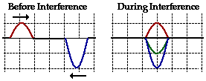

Destructive Interference
This time when they add together they will produce a smaller amplitude.
This is know as DESTRUCTIVE INTERFERENCE.

Slide 45
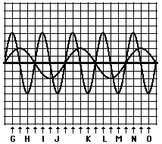
Check Your Understanding
Which points will produce constructive interference and which will produce destructive interference?
Constructive
  G, J, M, N
Destructive
  H, I, K, L, O

